Slide 1
Agile Methodology:
AGILE methodology is a practice that promotes continuous iteration of development and testing throughout the software development lifecycle of the project. Both development and testing activities are concurrent unlike the Waterfall model
The general principles of the Agile Method:
Satisfy the client and continually develop software.
Changing requirements are embraced for the client’s competitive advantage.
Concentrate on delivering working software frequently. Delivery preference will be placed on the shortest possible time span.
Developers and business people must work together throughout the entire project.
Projects must be based on people who are motivated. Give them the proper environment and the support that they need. They should be trusted to get their jobs done.
Face-to-face communication is the best way to transfer information to and from a team.
Working software is the primary measurement of progress.
Agile processes will promote development that is sustainable. Sponsors, developers, and users should be able to maintain an indefinite, constant pace.
Constant attention to technical excellence and good design will enhance agility.
Simplicity is considered to be the art of maximizing the work that is not done, and it is essential.
Self-organized teams usually create the best designs.
At regular intervals, the team will reflect on how to become more effective, and they will tune and adjust their behavior accordingly.

Slide 2
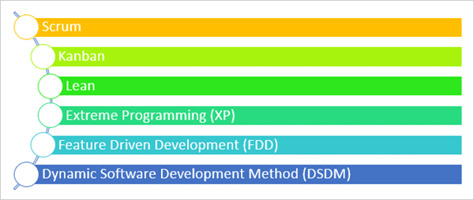
Types of Agile Methodologies:
There are several agile methodologies in practice across the world.

Slide 3
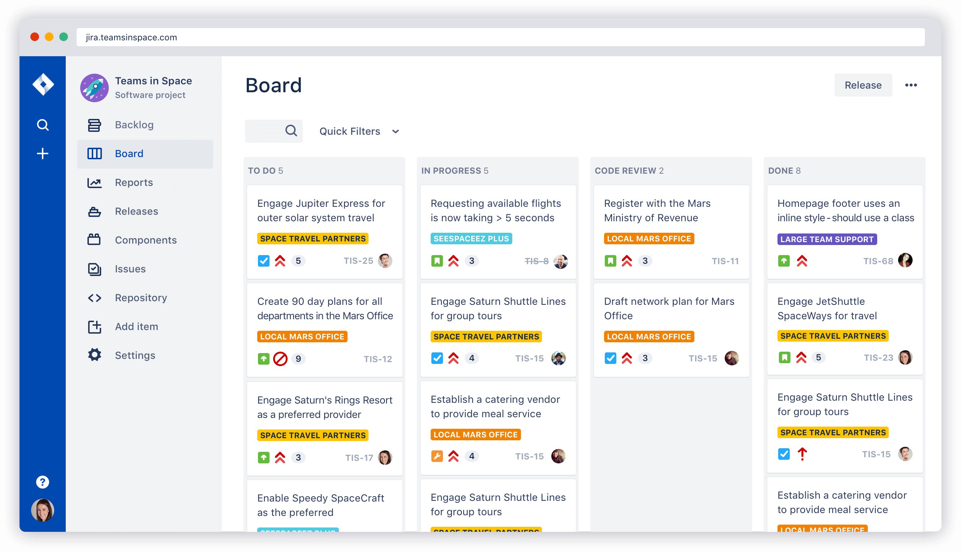
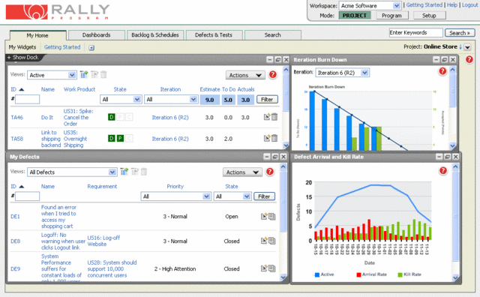
Tools which follow Agile - Scrum Methodologies
JIRA
RALLY

Slide 4
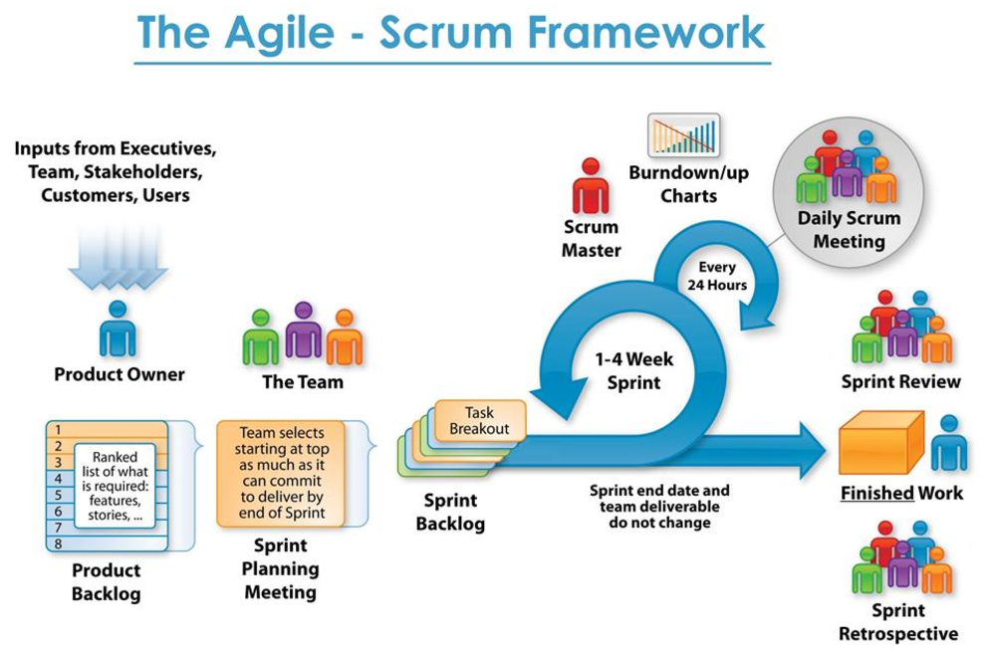

Slide 5
Terminology we use
SCRUM:
Scrum is a methodology that allows a team to self-organize and make changes quickly, in accordance with agile principles. A scrum team is made up of developers and testers, a product owner and a scrum master.
Scrum is an agile development method which concentrates specifically on how to manage tasks within a team-based development environment
Scrum Master:
A scrum master is the facilitator for an entire team. The scrum master manages the process for how information is exchanged.
Sprint:
Each iteration of a scrum is known as sprint. The sprint starts with the team committing to a set amount of work they can complete within the timeframe (sprint planning), at giffgaff the sprints are 2 weeks. The team will then work on the items that they have committed to, with the aim of completing everything by the end of the sprint. Throughout the sprint, features will be developed and demonstrated to the product owner and relevant stakeholders.
Product owner:
The product owner creates product backlog, prioritizes the backlog and is responsible for the delivery of the functionality at each iteration

Slide 6
PRODUCT BACKLOG:
This is a repository where requirements are tracked with details on the no of requirements to be completed for each
release. It should be maintained and prioritized by Product Owner, and it should be distributed to the scrum team.
Team can also request for a new requirement addition or modification or deletion.
PRODUCTDESIGNER:
Product designers use their design skills and technical knowledge to improve the way that existing products work and look, and/or produce them at a lower cost. They may also be involved in designing entirely new products Sprint:
SPRINT BACKLOG:
The sprint backlog is a list of tasks identified by the Scrum team to be completed during the Scrum sprint. During the sprint planning meeting, the team selects some number of product backlog items, usually in the form of user stories, and identifies the tasks necessary to complete each user story.
RETROSPECTIVE MEETING:
An Agile retrospective is a meeting that's held at the end of an iteration in Agile software development (ASD ). During the retrospective, the team reflects on what happened in the iteration and identifies actions for improvement going forward.

Slide 7

